Slide 1
LC-ESIMS Isotope pattern detection algorithm
LCMS_isotope_pattern_search_v2_1.R

Slide 2
Requirements:
Download and install:
R: https://www.r-project.org/
R studio: https://rstudio.com/
In R, install XCMS package: https://bioconductor.org/packages/release/bioc/html/xcms.html

Slide 3
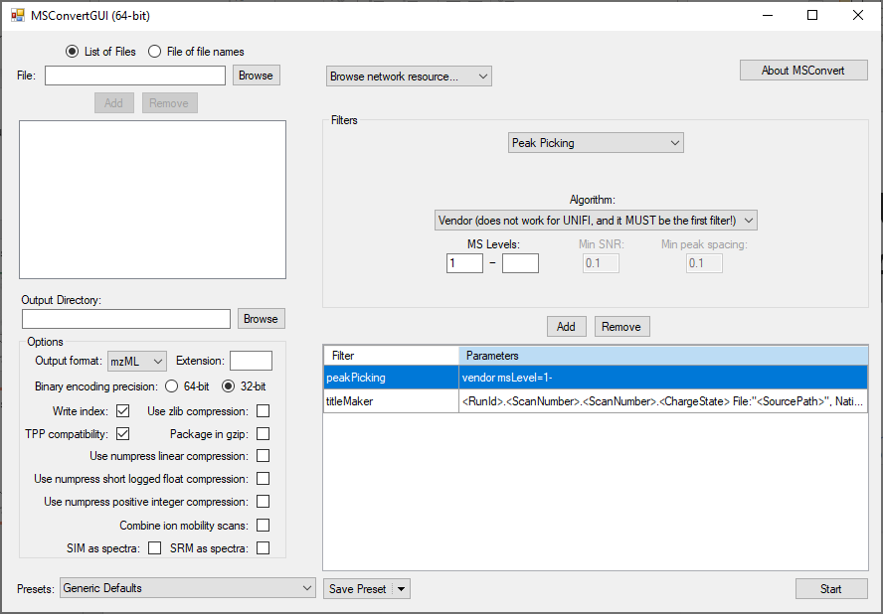
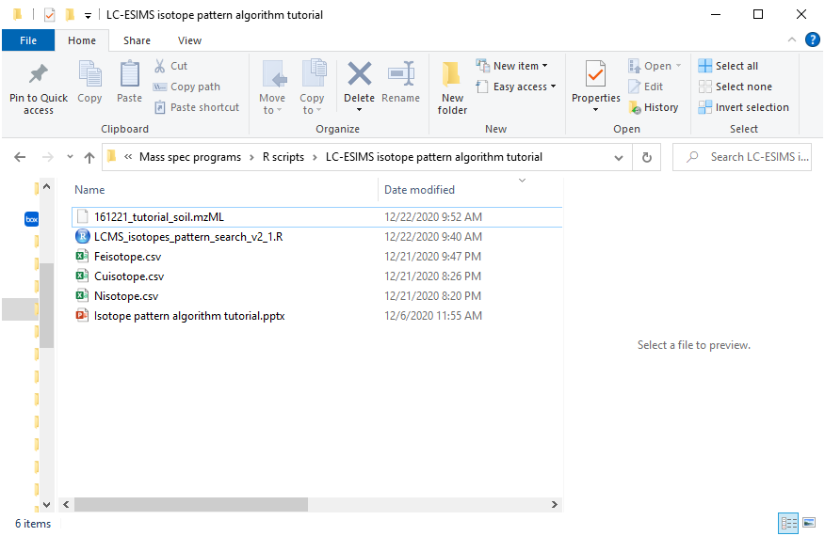
(1) Create folder with function files, isotope pattern files, and data files
Convert .RAW files from orbitrap to mzML with MSConvert
http://proteowizard.sourceforge.net/tools.shtml

Slide 4
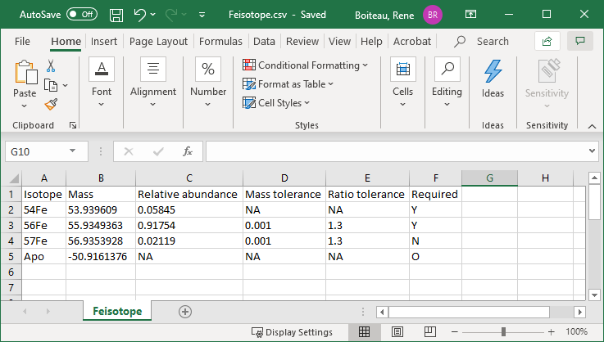
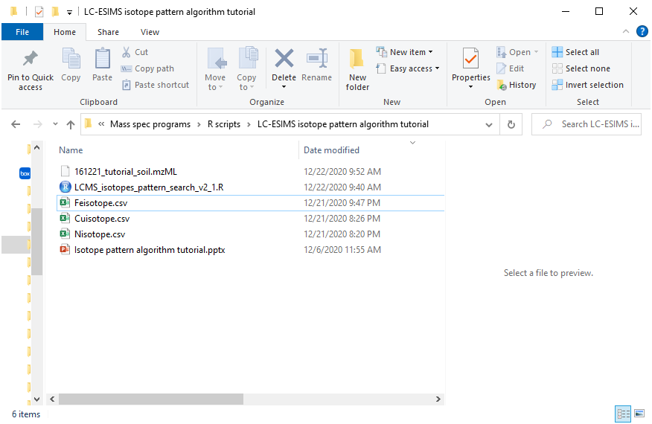
(1) Create folder with function files, isotope pattern files, and data files
Isotope pattern file format (.csv file)
Isotope: Must have at least two rows
Masses: Algorithm uses differences between each row
Relative abundance: Algorithm uses ratio between each row
Mass tolerance #: Peak pairs will be picked if Δm/z is within a window ± this # (first row isn’t used)
Ratio tolerance #: Peak pairs will be picked if Light/Heavy is within a factor of this # (first row isn’t used)
Required: ‘Y’ if used to pick peaks, ‘N” if used to plot only, ‘O’
to plot

Slide 5
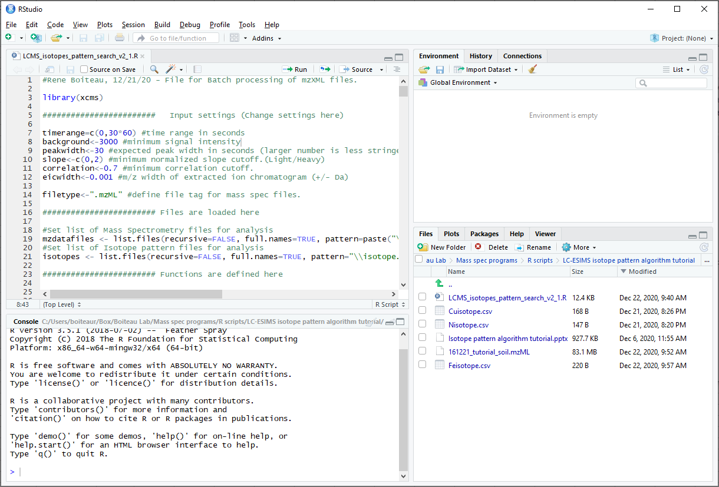
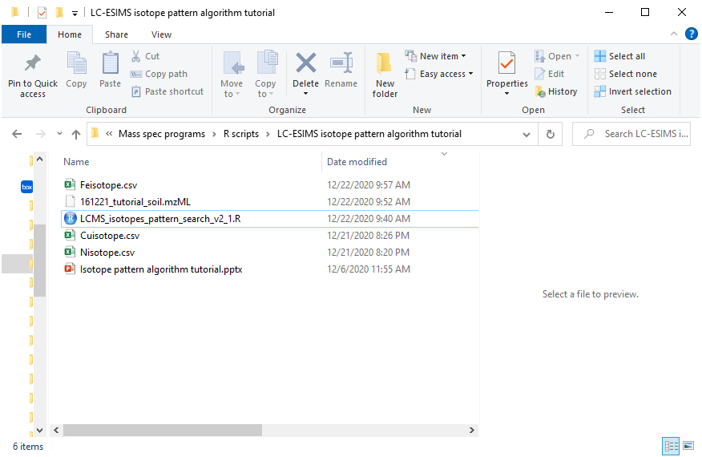
(2) Open template file in R-Studio

Slide 6
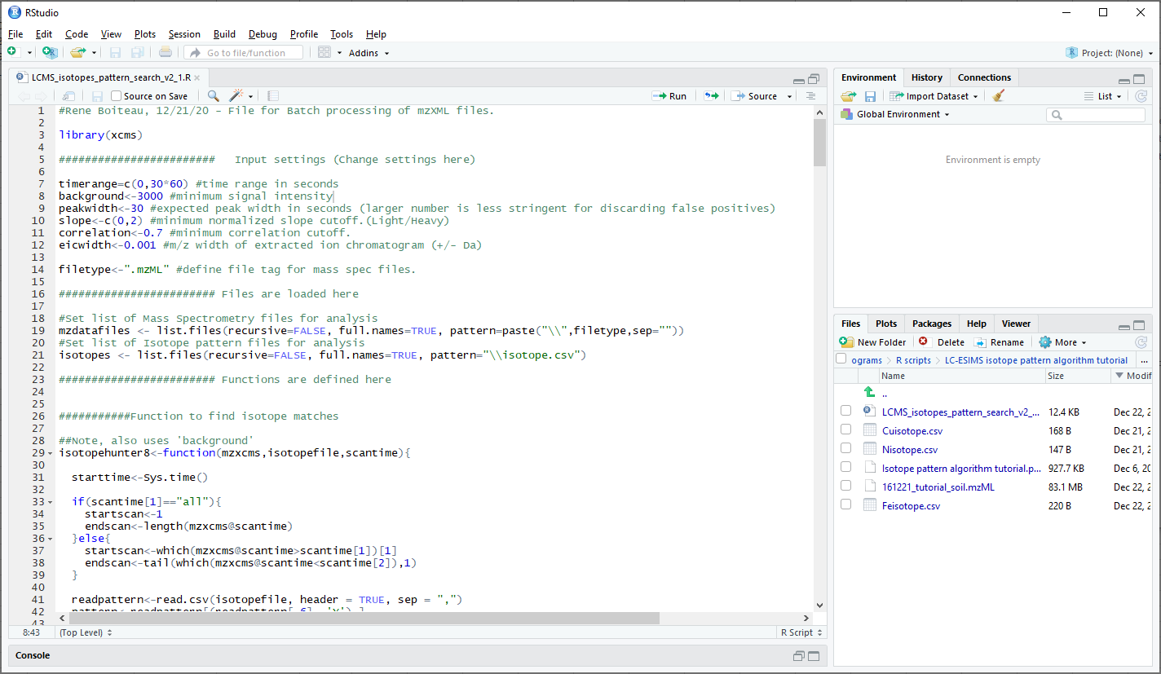
(3) Edit parameters if needed (LCMS_isotopes_batch_search.R)
This ‘batch mode’ script will search each mzXML file in your current directory for each isotope pattern (defined by the ‘.csv’ files) in the same directory and print out a report for each

Slide 7
(4) Press ‘source’ to run program

Slide 8
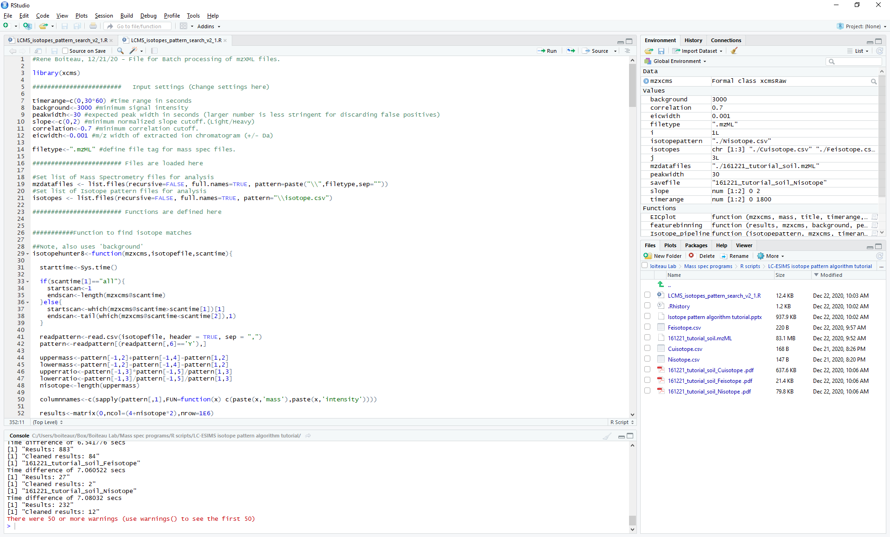
(5) Program generates report pdf with matches

Slide 9
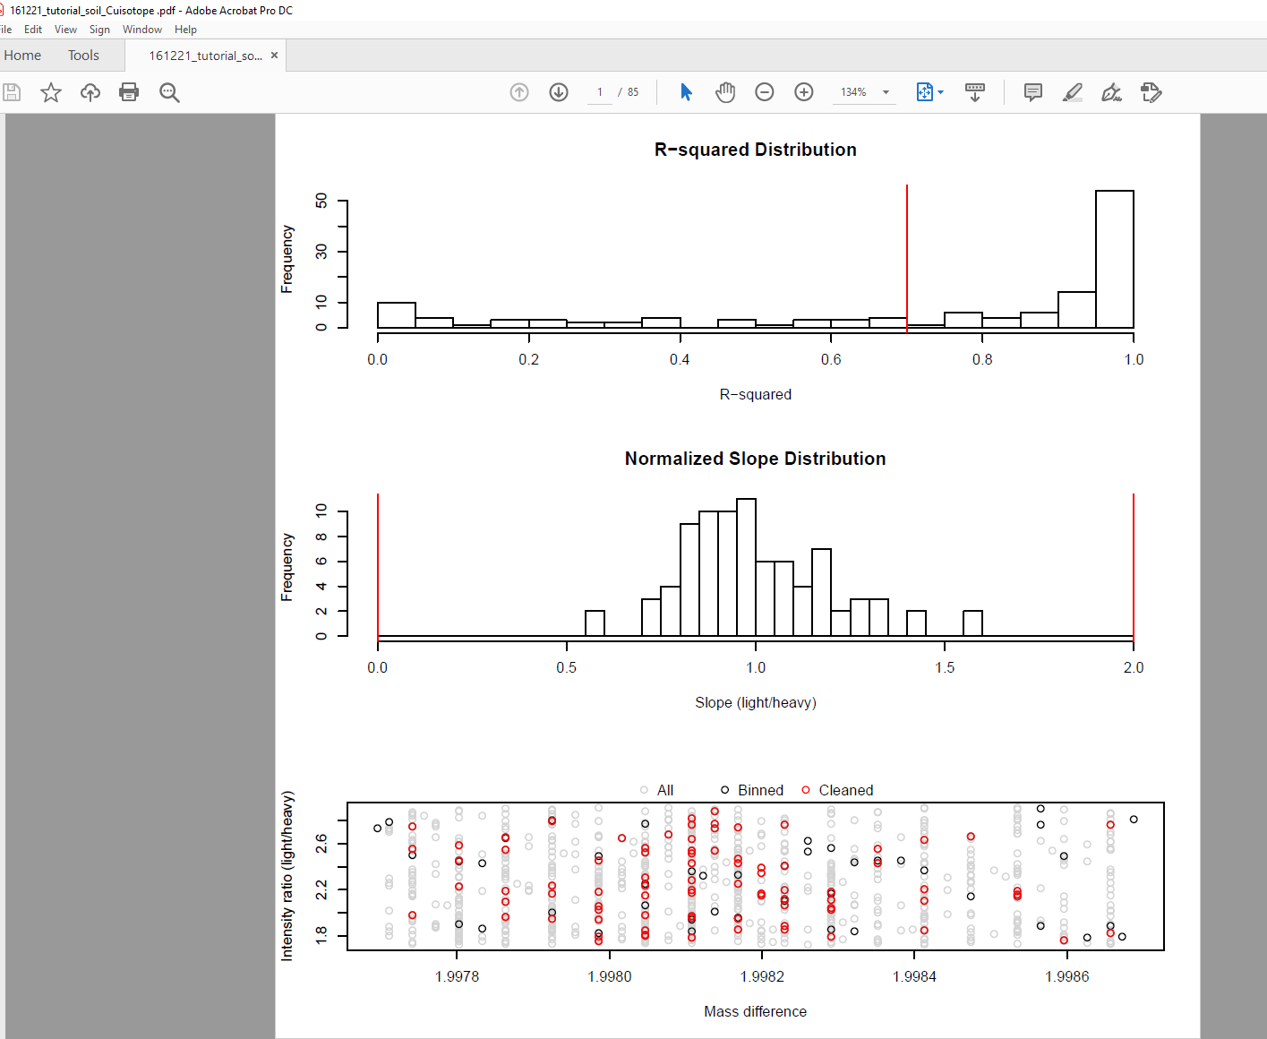
Report format: global QC
r² min cutoff
For every MS feature that matches the pattern,
An r² value is calculated across time
Slope cutoffs
Slope (ratio of light/heavy isotopes normalized to expected value)
Gray = all pattern-matched features detected
Black = maximum intensity features after binning
Red = validated features after r² and slope cutoff

Slide 10
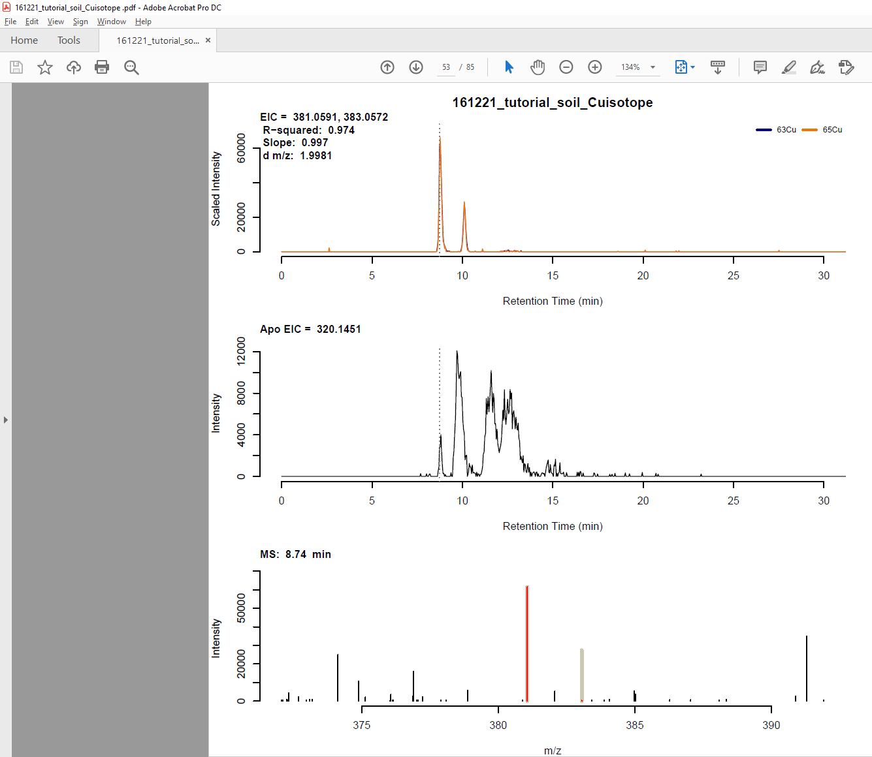
Report format: Validated features
EIC of validated features, with intensities scaled to
overlap relative abundances.
EIC of Apo form (requires ‘O’ option in isotope file)
MS of retention time corresponding to maximum peak
Red lines = true data, gray bar = expected pattern

